Slide 1



VOIS Innovation
Marathon 2.0

Slide 2
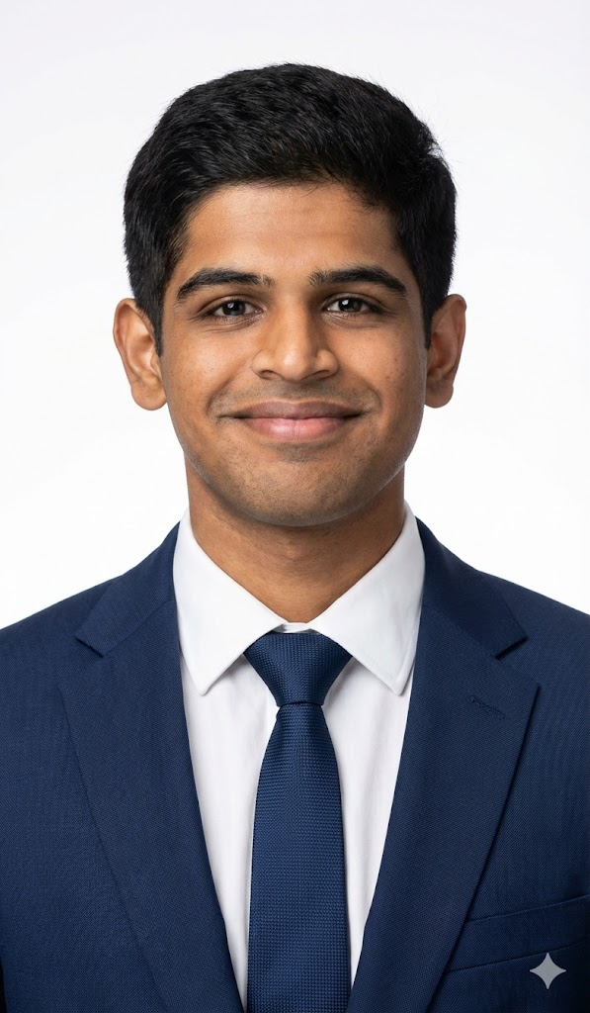

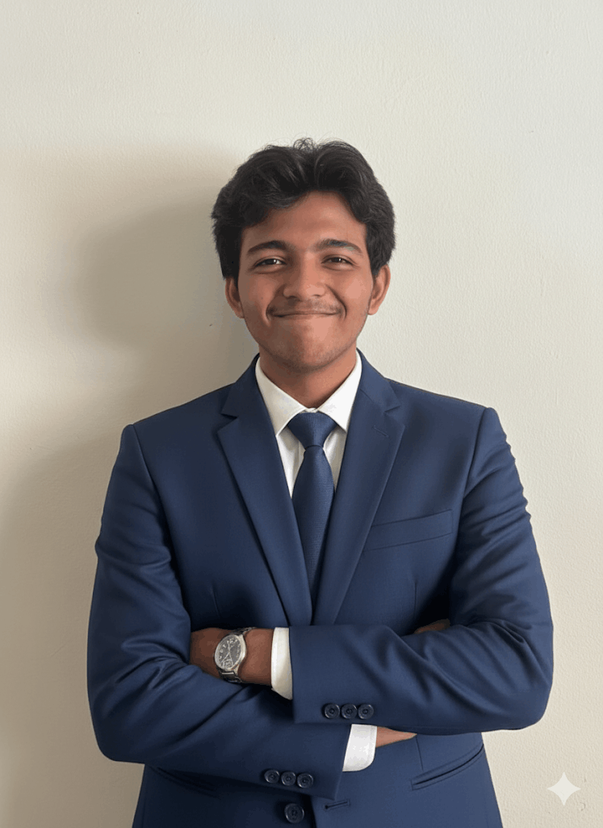
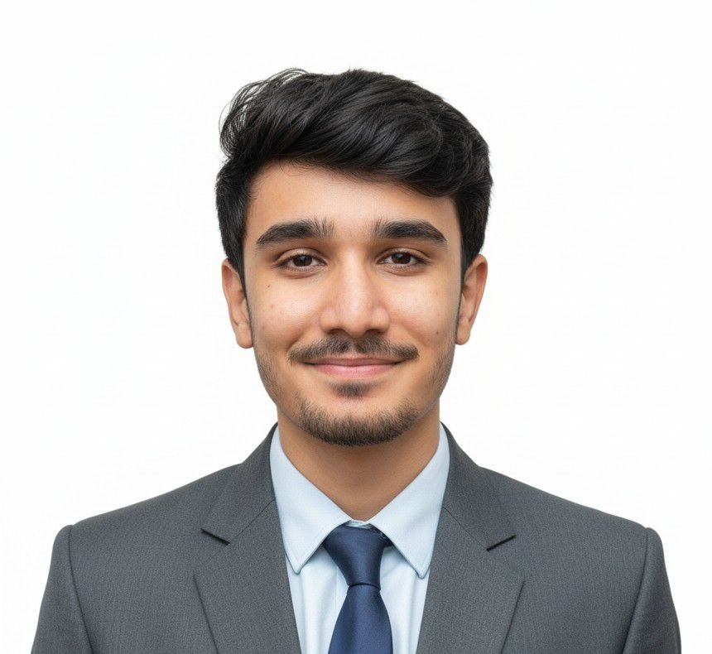
Project Title : Centralized Vulnerability Detection and Intelligent Query Interface (Integrated with agentic AI capabilities to provide guidance for cybersecurity learning)
Team Lead, Aadarsh Pathre, AIML
Team No.79
Insert your professional photo
Vishwakarma University , Pune ,Maharashtra
Varun Inamdar ,AIML
Piyush Dhoka, AIML

Slide 3





Problem Statement
Centralized Vulnerability Detection and Intelligent Query Interface (Integrated with agentic AI capabilities to provide guidance for cybersecurity learning)
Current Challenges in Cybersecurity
Fragmented Tooling & Scattered Intelligence: Current security operations rely on disconnected scanners, forcing teams to manually correlate data. This fragmentation prevents a unified view of the organization’s actual risk posture.
Ineffective Risk Communication: Technical scan outputs are hard for non-technical stakeholders to understand, delaying informed decision-making and remediation.
Cybersecurity Skill Gap: Academic and industry research shows a gap between theoretical learning and real-world security operations, with limited hands-on exposure.
Lack of Intelligent & Adaptive Platforms: Existing tools and learning systems lack AI-driven personalization, natural language interaction, and integrated vulnerability intelligence.

Slide 4
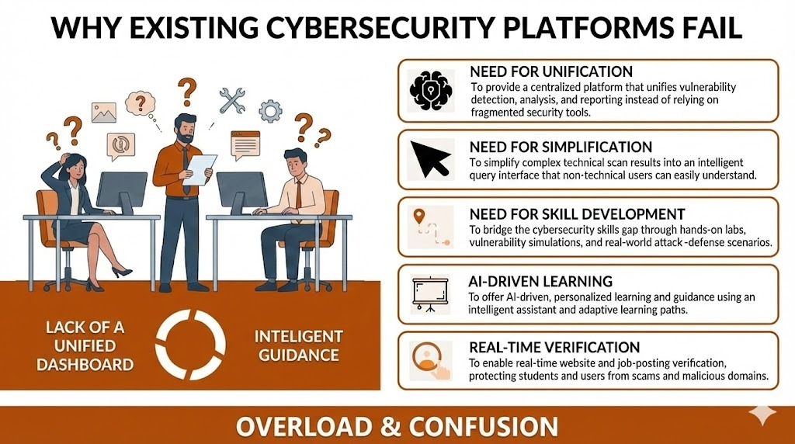

Need of Project

Slide 5
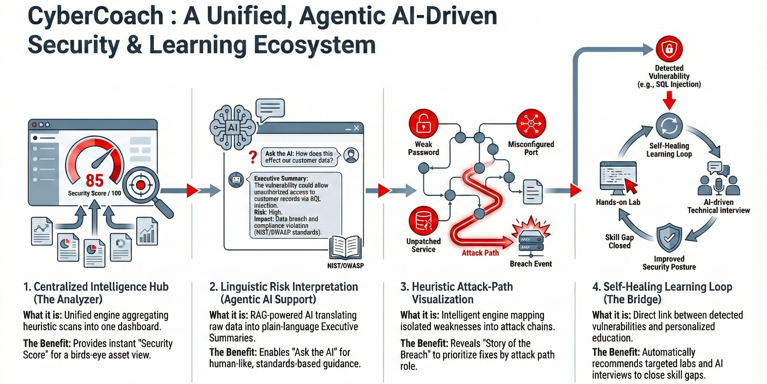
Proposed Solution

Slide 6
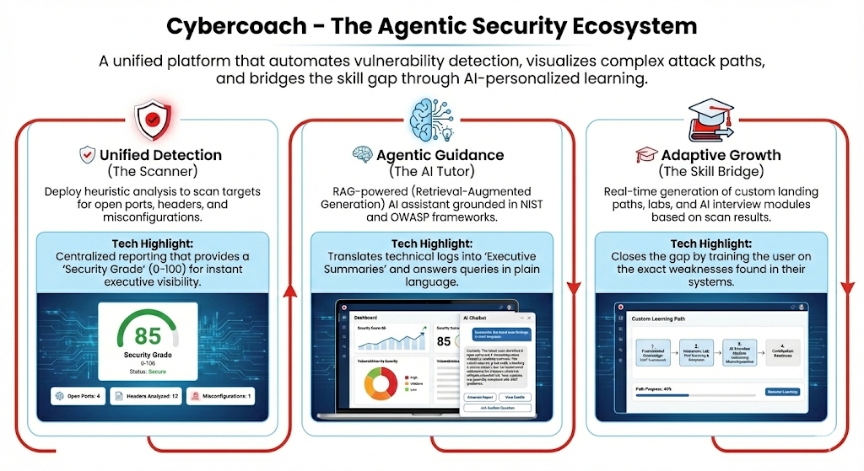
Solution Overview

Slide 7
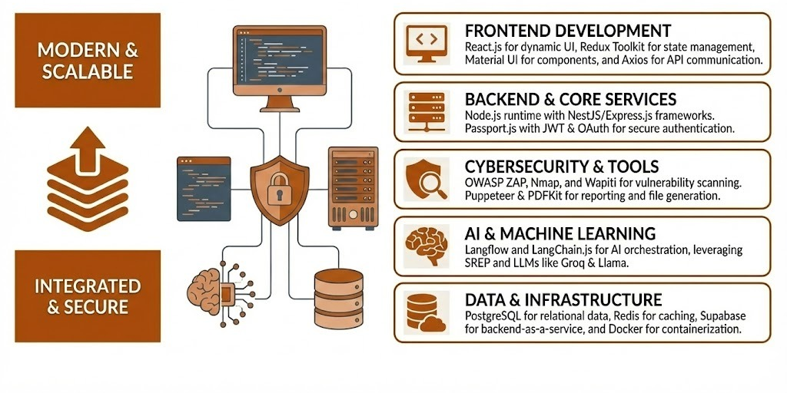
Technology used

Slide 8
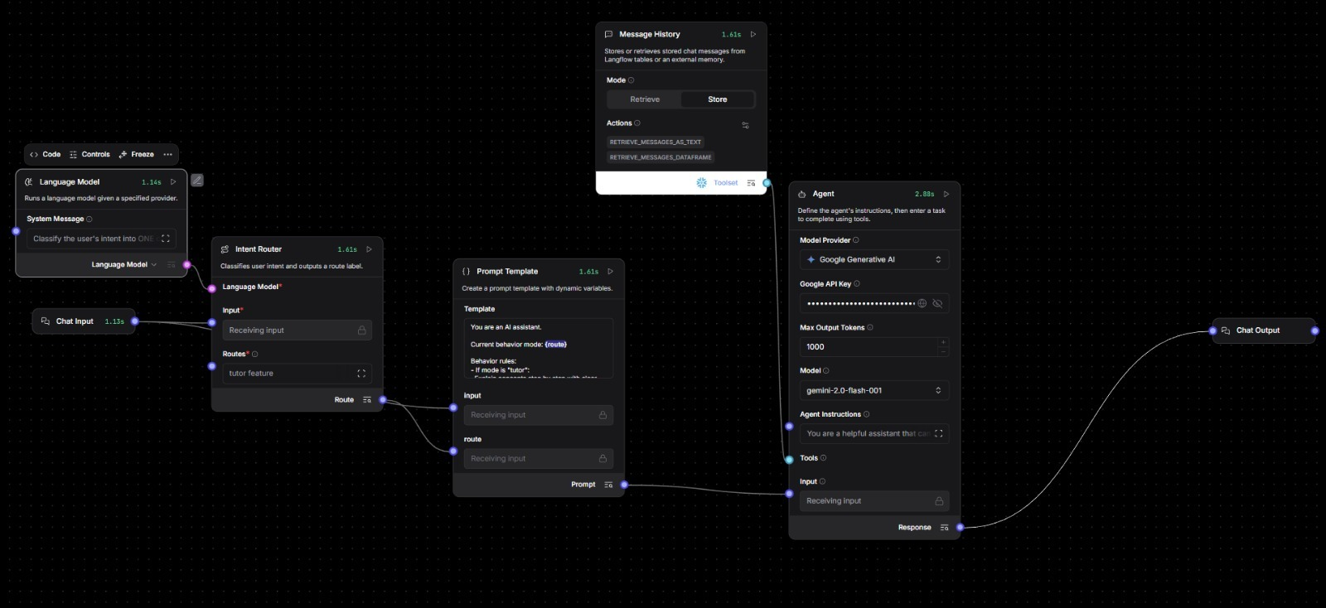
Langflow Diagram

Slide 9
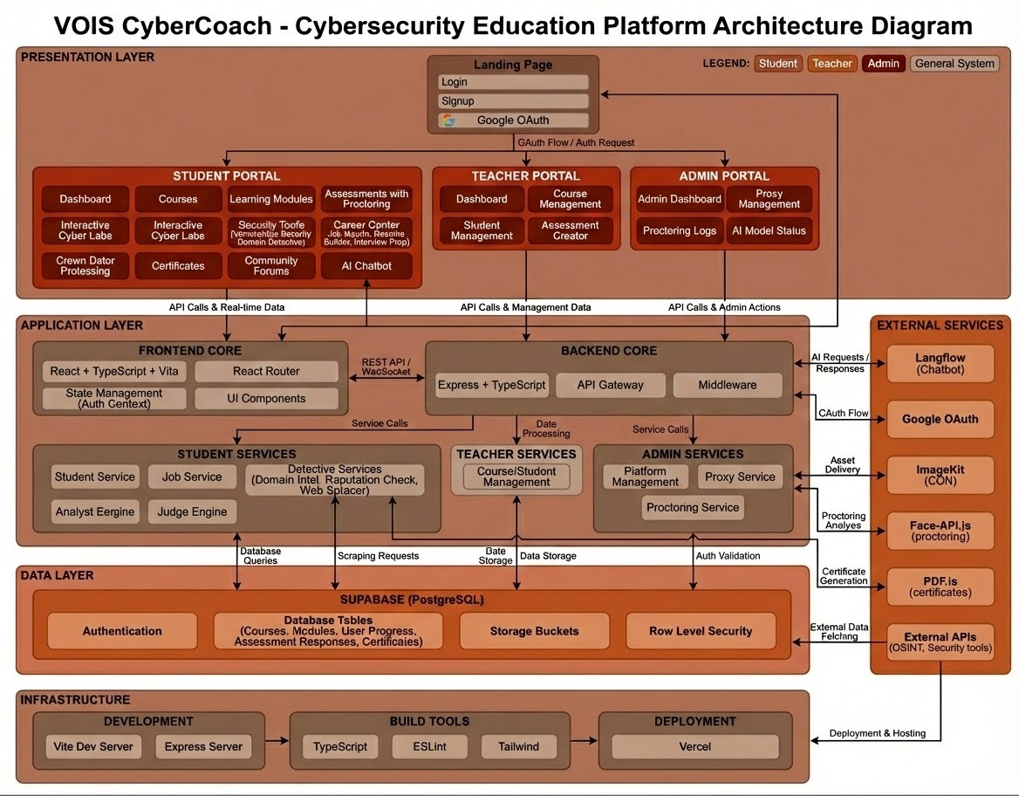
Technical flow diagram -

Slide 10
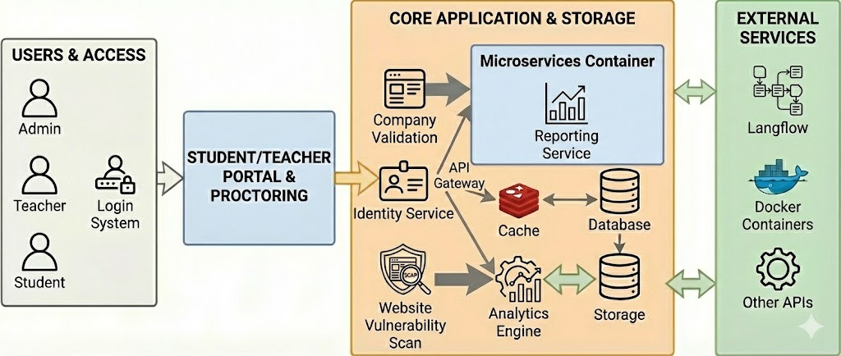

Architecture Blueprint

Slide 11
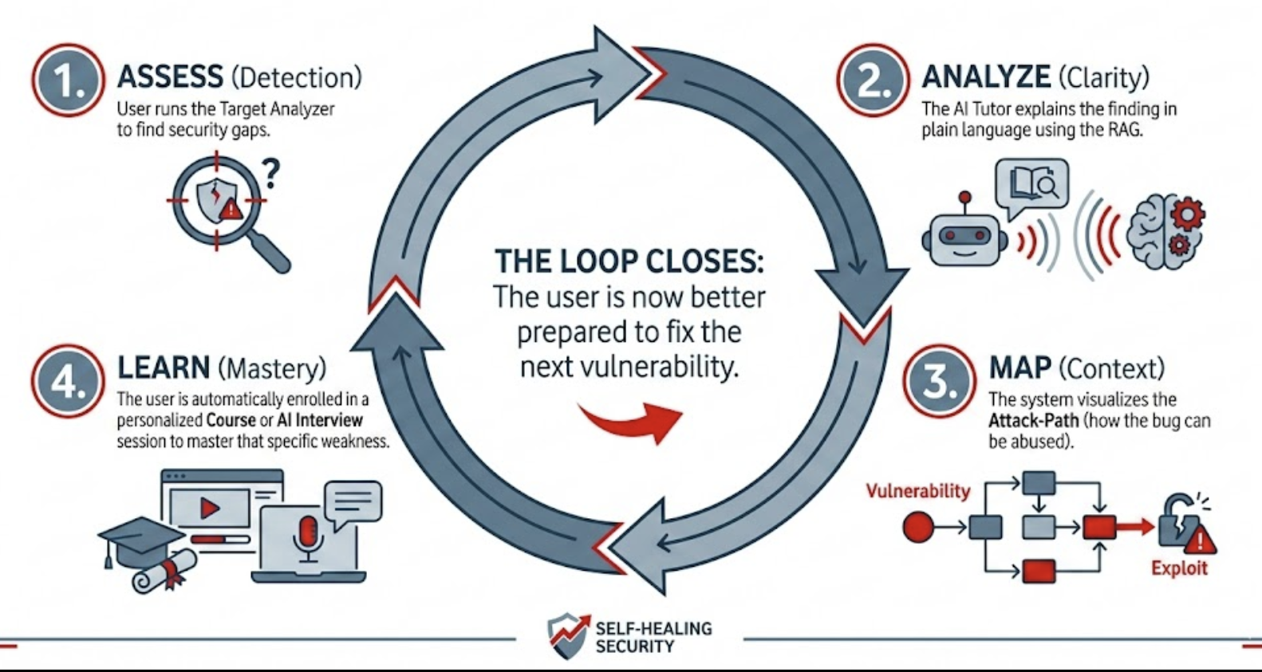
Workflow diagram

Slide 12
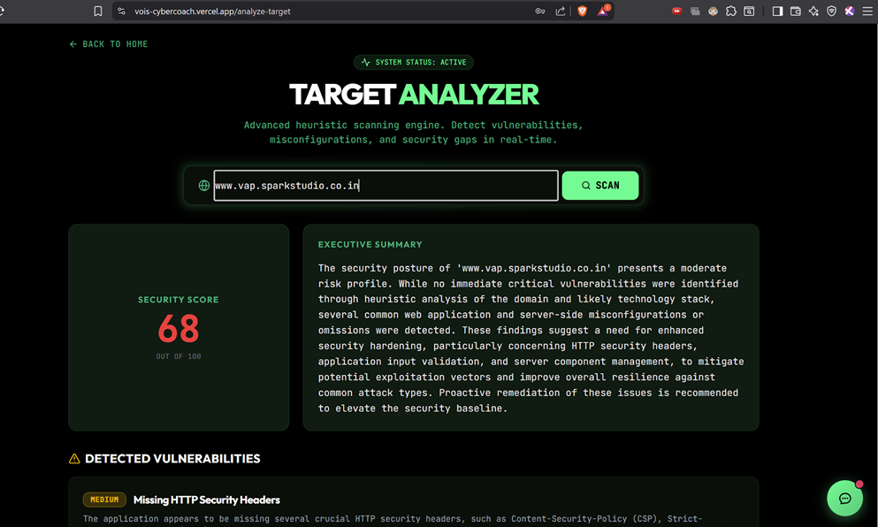
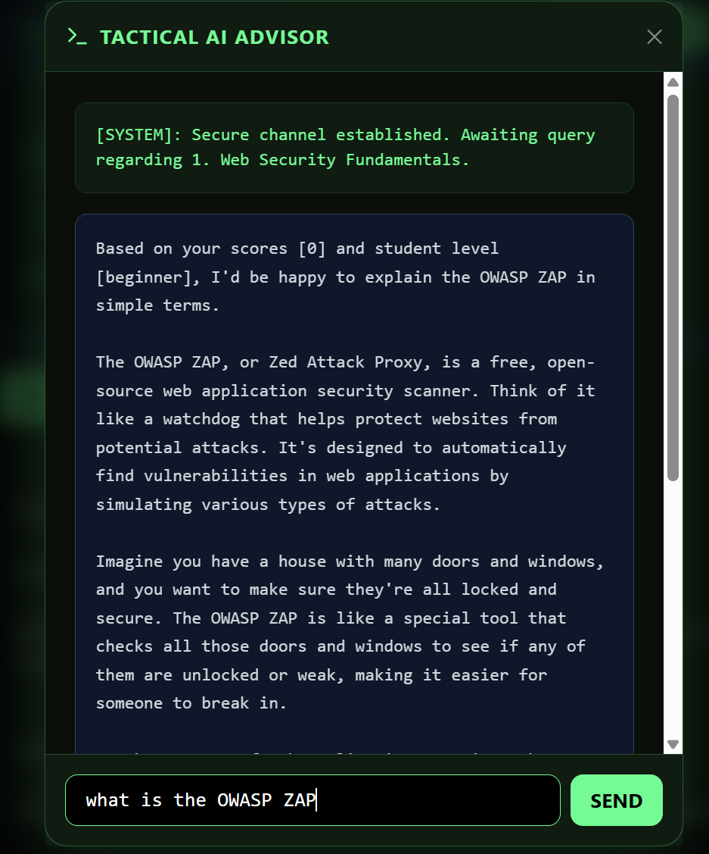
Screen shots of your project -

Slide 13
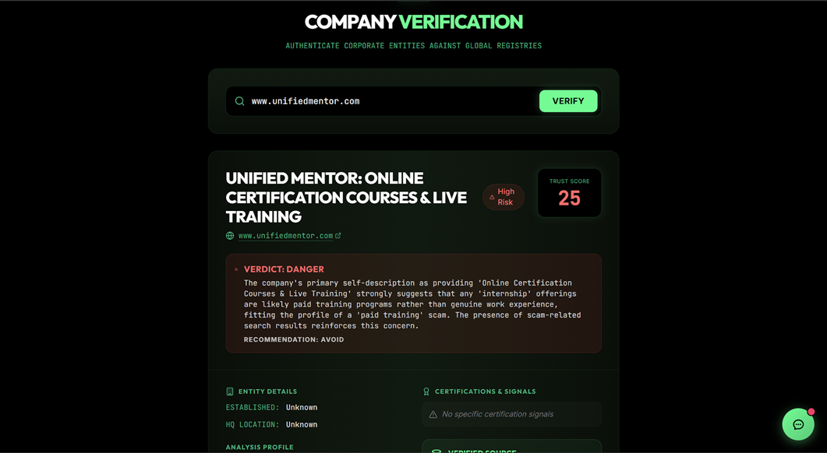
Screen shots of your project -

Slide 14
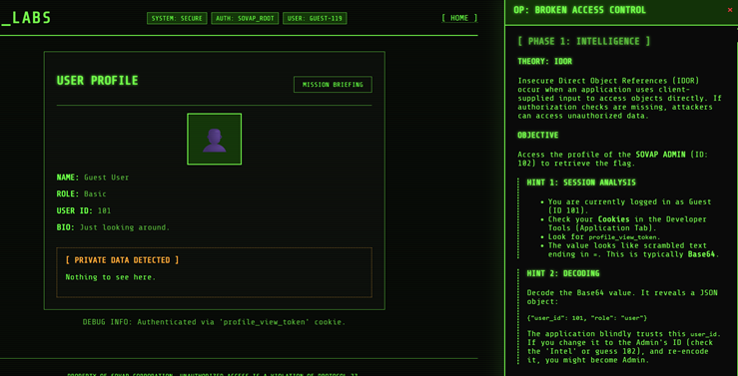
Screen shots of your project -

Slide 15
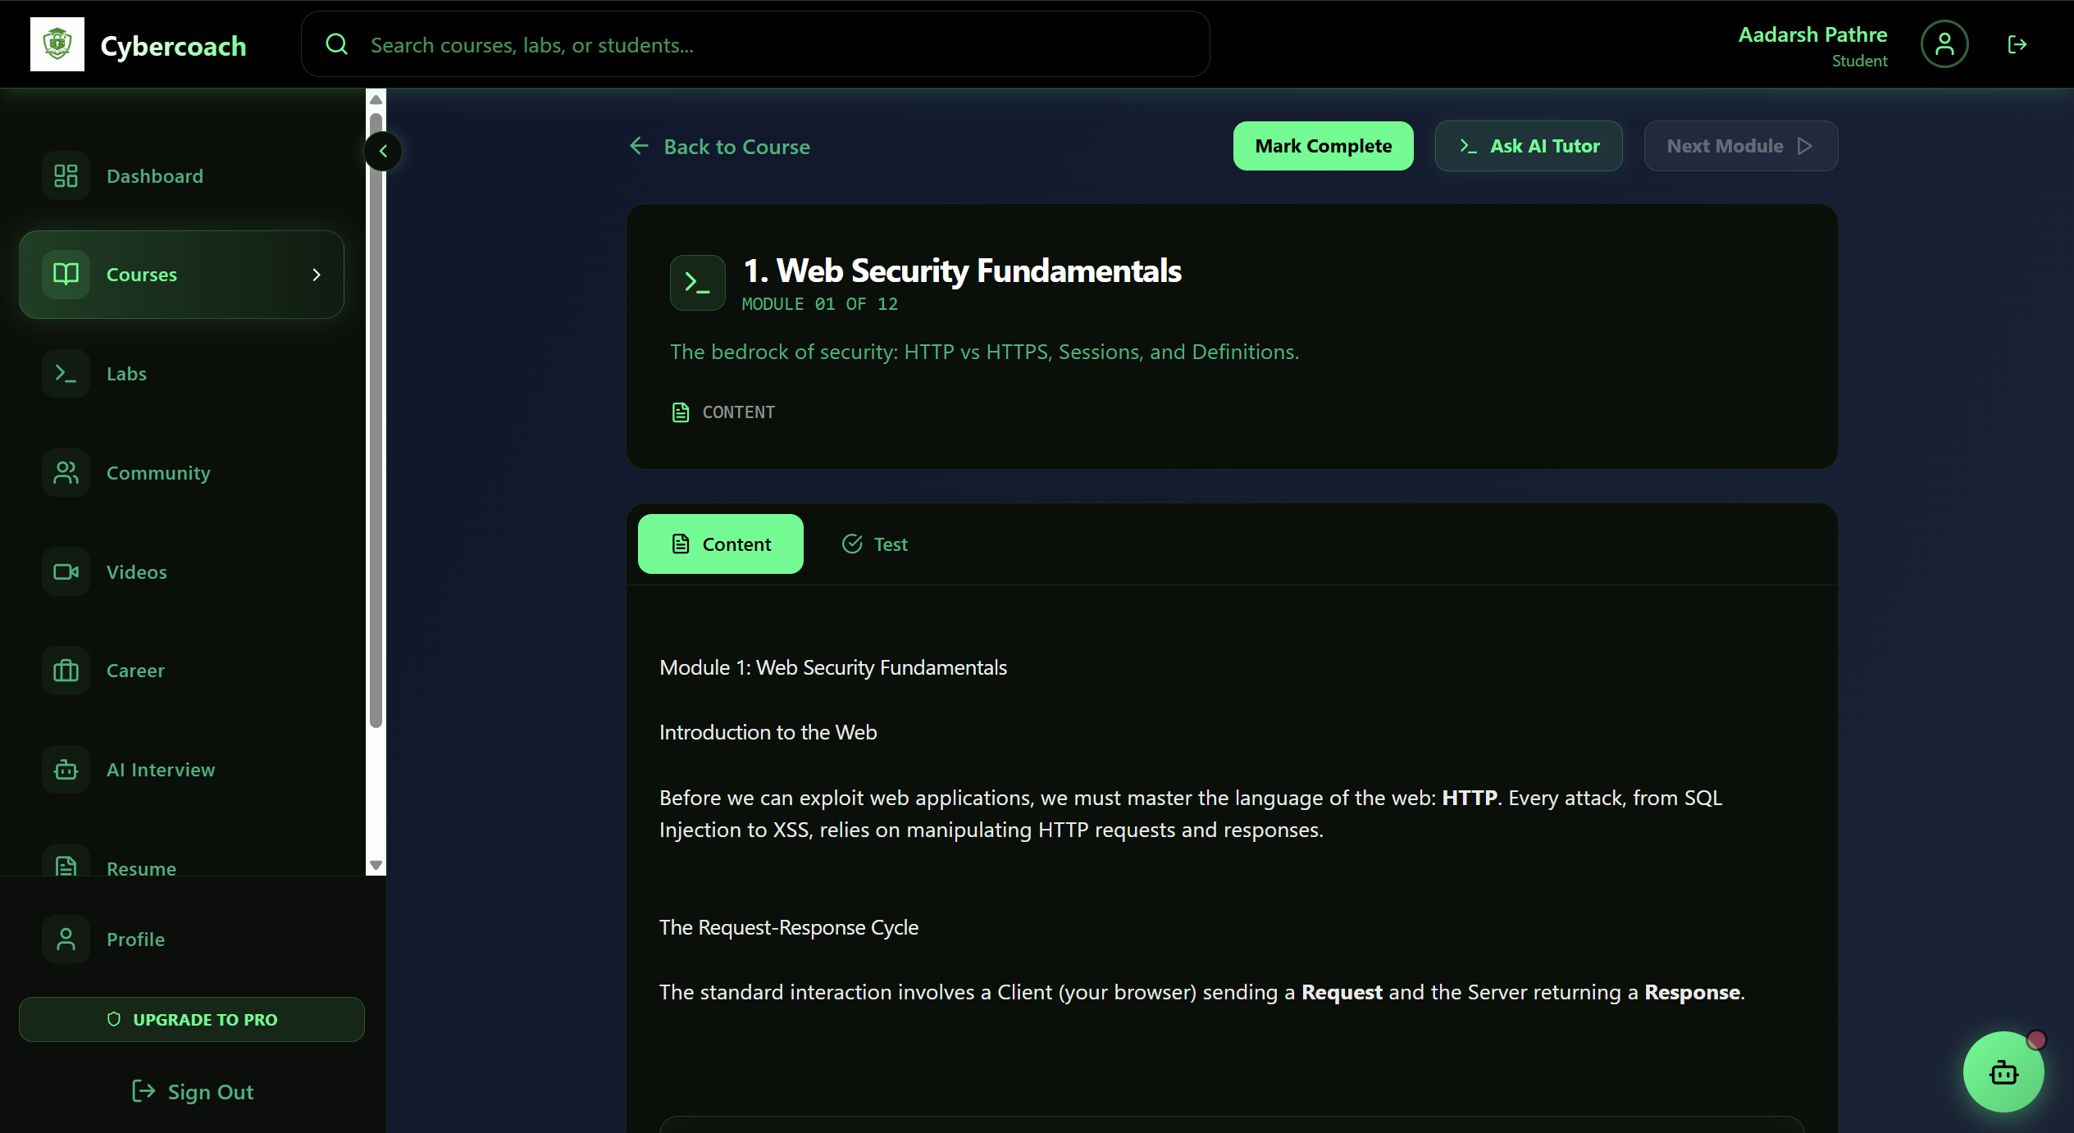
Screen shots of your project -

Slide 16
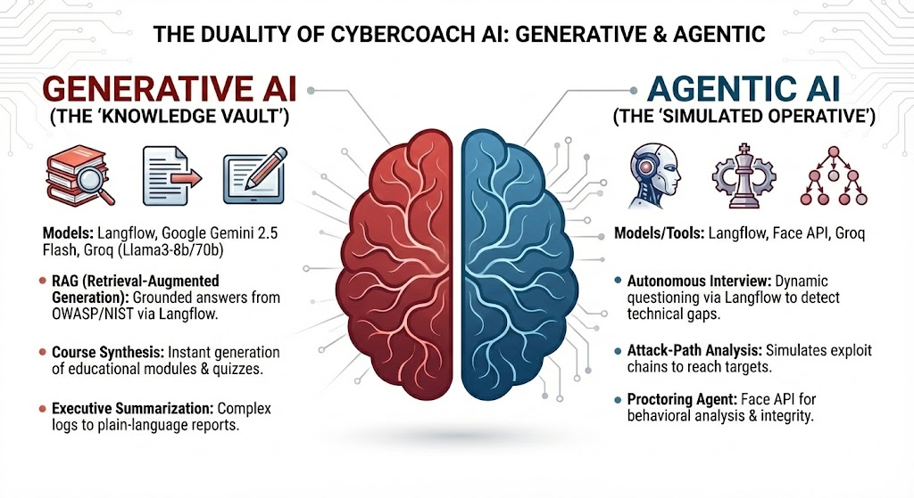

Role of Agentic AI and Gen AI in the solution

Slide 17
Novelty and Uniqueness
1
2
3
4
The platform innovates by allowing users to query complex security data using plain English, delivering business-ready answers without requiring code.
Offers a proactive "visual attack-path mapping" feature that connects isolated weaknesses to reveal potential breach routes before an attack actually occurs.
The solution introduces a novel hybrid model that simultaneously improves enterprise security operations and builds a pipeline of job-ready talent on a single platform.
This solution uniquely immerses learners in live, actual vulnerability findings for authentic, high-stakes experience.

Slide 18
Git Hub Link
Please create public GitHub repository (Enable Add README button while creating repository)
with format:
Please test and Paste the working GitHub URL – AadarshCanCode/VOIS_cybercoach
https://vois-cybercoach.vercel.app/
Make sure you have Uploaded following three files into your github repository
1. app.py file ,
2. your_hackthon_problemstatement.pdf file
3. your projectpresntation.pptx file

Slide 19
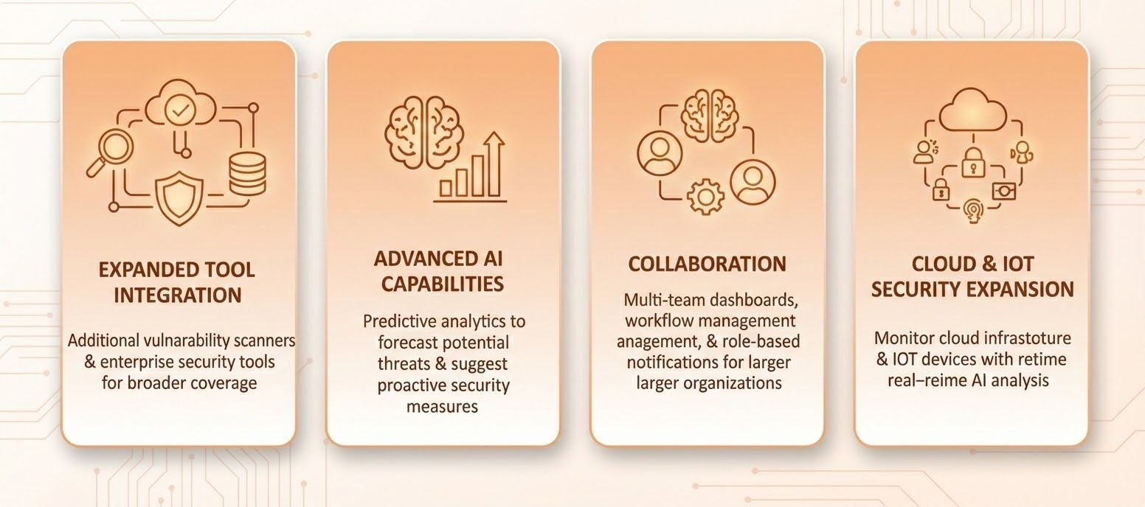
Future Scope

Slide 20
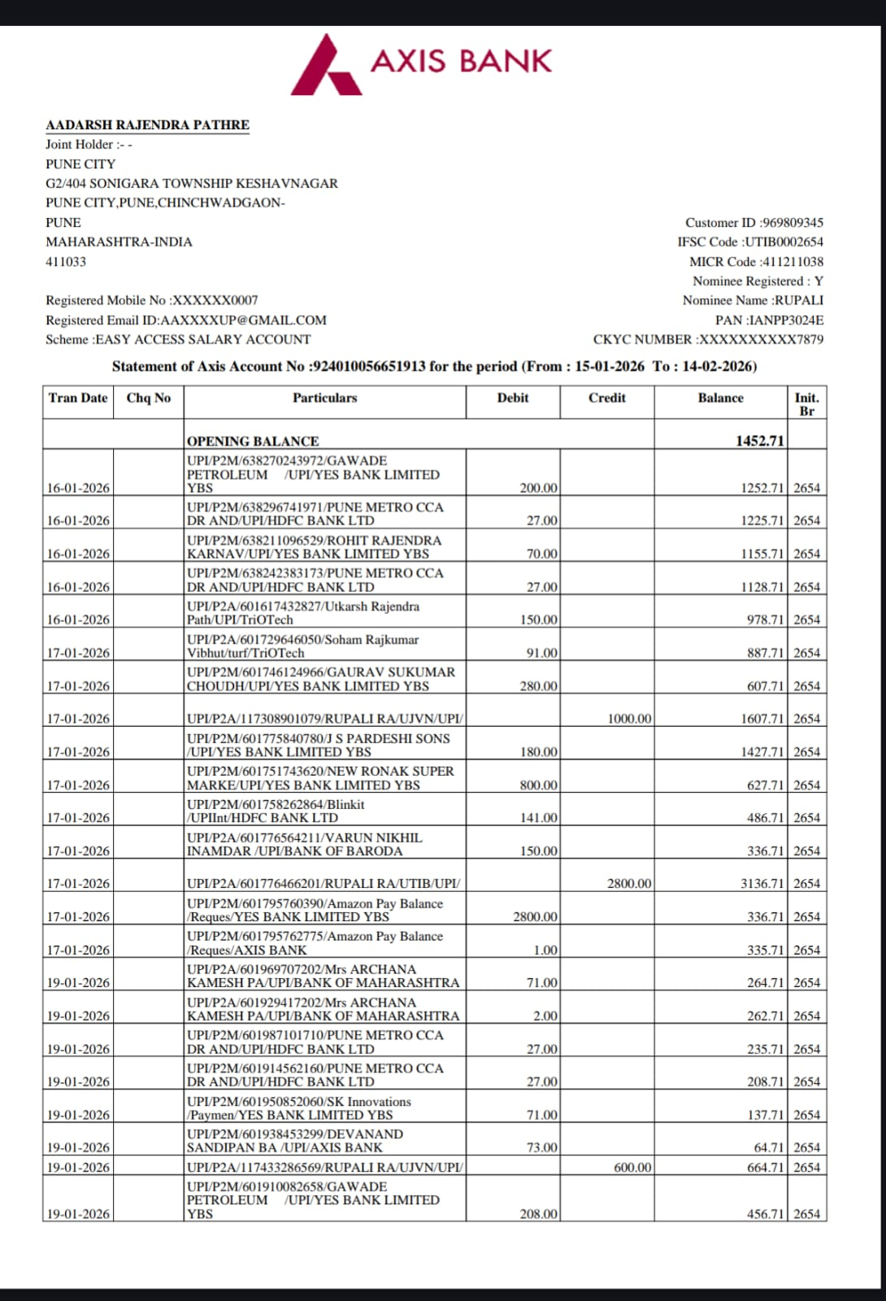
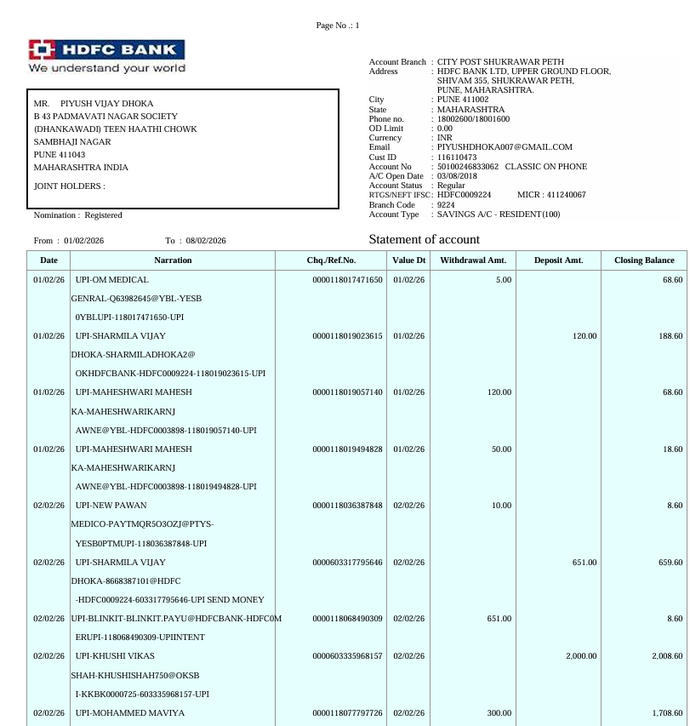
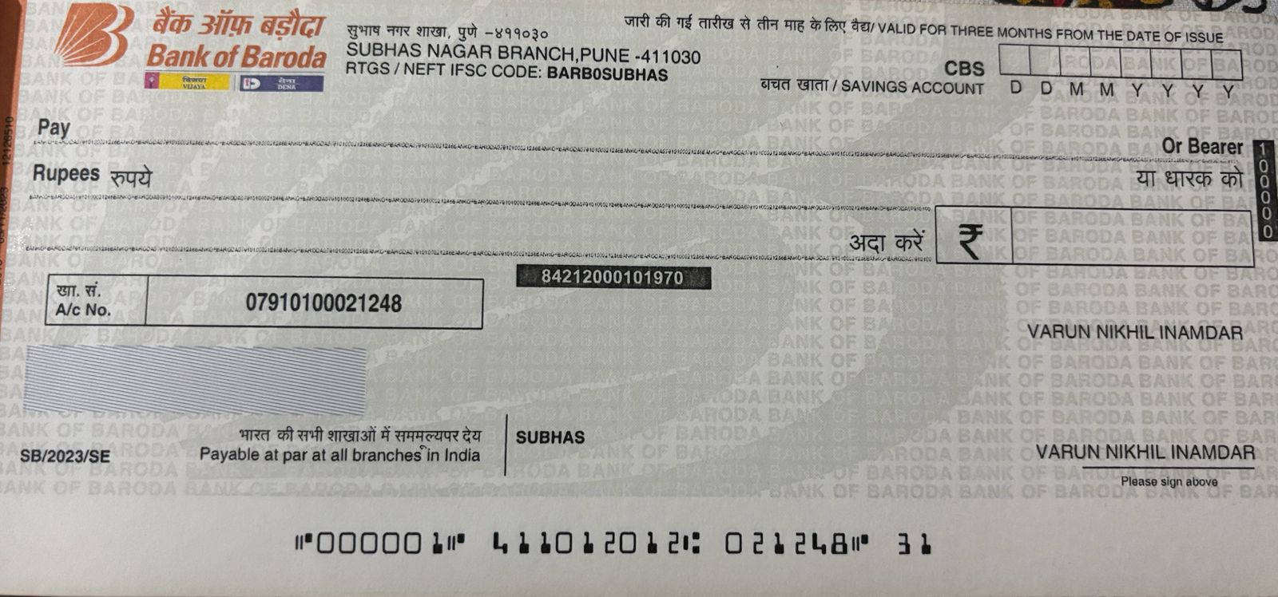
Bank Details
Full Name (as per bank records): | Bank Name | Branch Name | Account Number | Account Type (Savings / Current) | IFSC Code
PIYUSH VIJAY DHOKA | HDFC BANK | CITY POST SHUKRAWAR PETH | 50100246833062 | Savings | HDFC0009224
Varun Nikhil Inamdar | Bank of Baroda | Subhashnagar Branch | 07910100021248 | Savings | BARBOSUBHAS
Aadarsh Rajendra Pathre | Axis Bank | Chikhali Road, P Pune Mh | 924010056651913 | Savings | UTIB0002654
Insert photo of passbook / bank statement
Team Member 1 Passbook/ Bank Statement With Name and Account Number
Team Member 2 Passbook/ Bank Statement With Name and Account Number
Team Member 3 Passbook/ Bank Statement With Name and Account Number

Slide 21
Thank You

